Slide 1
Optical Communications And Networks
BY
Seema Ansari

Slide 2
Recommended Text
Fiber Optics Communications By Joseph C. Palais
Fiber Optics Communications By Harold Kolimbiris

Slide 3
INTRODUCTION
In a communications system, the volume, speed, and clarity of information processed are key parameters that determine its performance level.
Research and development has concentrated its effort on increasing the volume and improving the quality of information processed through the system.
Until recently, the primary means of transmission were the electromagnetic waves.
However, the increasing demand for a high volume of processed information, has generated the need for a corresponding increase in carrier frequencies and bandwidths.

Slide 4
Carrier frequencies present certain limitations in higher ranges. These limitations generated the incentive to search for new ways to increase the carrier frequencies thus improving the information carrying bandwidth
Optical fibers fibers are the most suitable media, because they present theoretically unlimited possibilities.
A great interest in optical communications was triggered in the 1960s with the development of optical sources. These sources were capable of generating frequencies of about
with a corresponding increase in the information capacity by 100,000%

Slide 5
In optical communications systems the medium of information transmission is the light. Therefore the nature and behaviour of light must be examined.
The study of light is commonly referred to as optics and is divided into three main categories: geometric optics, physical optics and quantum optics.
Geometric optics treat light as it were composed of individual light rays.
Physical optics treats light as a wave phenomenon
Quantum optics treats light as quanta.

Slide 6
Fiber Optic Communications Systems
Chapter-1
Outline:
- Historical Perspective
-The Basic Communications Systems
- Nature of Light
- Advantages of Fibers
- Applications of Fiber Optic Communications
- Summary
- Problems

Slide 7
Historical Perspective
This chapter explains the fundamentals of several subjects on which the technology is based. These includes:
Fibers
Optics
Communications
Optic Communications and finally, complete communications systems.

Slide 8
Historical Perspective
Communication using light occurred early in the development when human beings first communicated by using hand signals.
- Limitations: Information transfer rate was slow; limited distance; high error rate.
A later Optic system, useful for longer transmission paths was the smoke signal.
In 1880, Alexander Graham invented, a light Communication system, the photophone to carry conversation.
All these systems had low information capacities.
A major breakthrough that led to high capacity optic communications was the invention of the laser in 1960.

Slide 9
Glass produced were too lossy for modern long distance communications.
In 1970, first truly low loss fiber was developed and fiber optic communications became practical.

Slide 10
Basic Communications System
Information Channel
Transmitter: At the transmitter the message is generated and put into a form suitable for transfer over the information channel.
Information Channel: Information travels from the Tr to the Rr over this channel.
- Unguided channel (atmosphere)-TV broadcast; Microwave relay links.
- Guided channel (two wire line, coaxial and rectangular waveguide)
Transmitter
Receiver

Slide 11
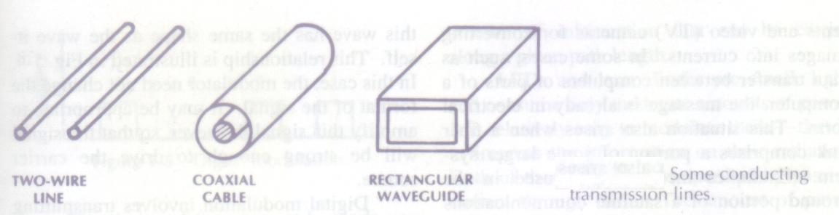
Some conducting Transmission lines

Slide 12
Advantages of Fiber-waveguides and other guided channels
privacy
No weather dependence and
The ability to convey messages within, under, and around physical structures.

Slide 13
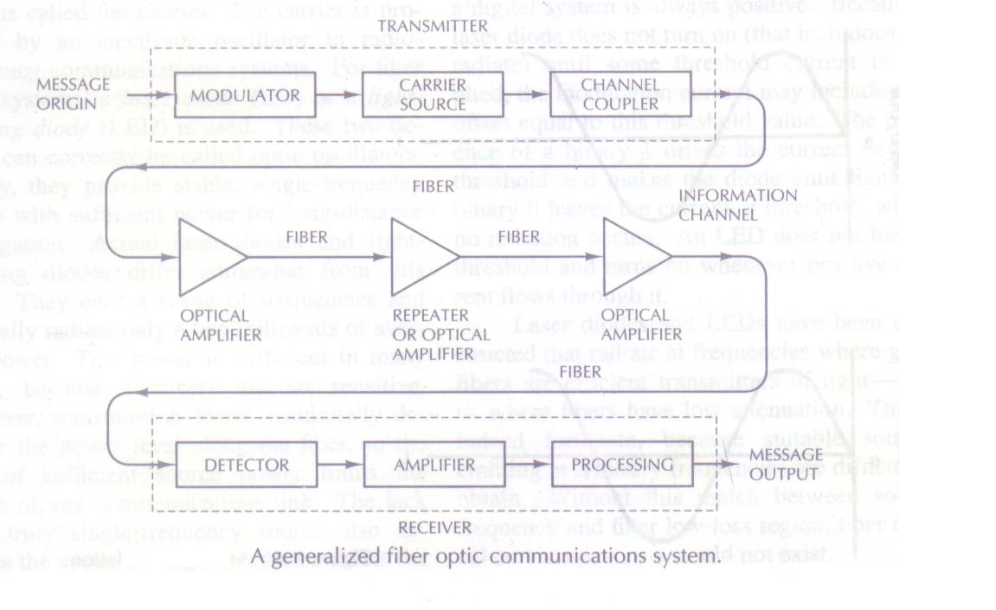
A generalized fiber optic Communications system

Slide 14
Main elements of communications system.
Message Origin: may take several physical forms. Quite often it is a transducer that converts a non-electrical message into an electrical signal e.g. microphones for converting sound waves into currents and video cameras for converting images into currents.
In any case, the information must be in electrical form before transmission for either electronic or optic communications.

Slide 15
Main elements of communications system.
Modulator: has two main functions. First, it converts the electrical message into the proper format. Second, it impresses the signal onto the wave generated by the carrier source.
Carrier Source: The carrier source generates the wave on which the information is transmitted. This wave is called the carrier. The carrier is produced by an electronic oscillator in RF communications systems. For fiber optic systems, a laser diode (LD) or a light emitting diode (LED) is used. These two devices can also be called optic oscillator. (Read pg-5)

Slide 16
Main elements of communications system.
Channel Coupler: This feeds power into the information channel. In a radio and TV broadcasting system, this element is an antenna. The antenna transfer the signals from the transmitter onto the information channel, in this case the atmosphere.
In a guided system using wires, such as a telephone link, the coupler need only be a simpler connector for attaching the Tr to the transmission line being used as the info channel.

Slide 17
Main elements of communications system.
Cont’d:
For an atmospheric optic system, the channel coupler is a lens used for collimating the light emitted by the source and directing this light toward the receiver.
In fiber system, the coupler must efficiently transfer the modulated light beam from the source to the optic fiber.
Unfortunately, it is not easy to accomplish this transfer without relatively large reductions in power or somewhat complicated coupler designs.
One difficulty arises because of the small size of conventional fibers, which have diameters of the order of 50 millionths of a meter.
However, the large loss basically occurs because light sources emit over a large angular extent.
Fibers can only capture light within more limited angles, as illustrated in the next figure.(fig-1.7)

Slide 18
Figure 1-7: Coupling of light to the fiber.
The simplest type of coupler is shown. The light emitter is merely butted against the fiber.
As indicated, even if the fiber is big enough to intercept all the light rays emitted by the source, the light will not be entirely collected because of the difference between the radiation and acceptance cone angles. More efficient, but also more complex, couplers can be constructed.
The channel coupler is an important part of the design of a fiber system because of the possibility of high losses.
Untrapped Rays
Fiber
Source
Trapped Rays
Coupling light to the fiber
Figure 1-7

Slide 19
Main elements of communications system.
Information Channel: refers to the path b/w the Tr and Rr. In fiber optic comms., a glass (or plastic) fiber is the channel.
Desirable characteristics of the information channel include low attenuation and large light-acceptance-cone angle. Low attenuation and efficient light collection are particularly necessary for transmission over long path lengths.
Although highly sensitive receivers are available, the power delivered to the receiver must be above some limiting value to obtain the desired message with appropriate clarity.
Optical amplifiers boost the power levels of weak signals. Amplifiers are needed in very long links (hundreds and thousands of kilometers) to provide sufficient power to the receiver.
Repeaters can be used only for digital systems. They convert weak and distorted optical signals to electrical ones and then regenerate the original digital pulse trains for further transmission. In a long system numerous amplifiers and repeaters may be utilized.

Slide 20
Property of Information channel
An important property of the information channel is the Propagation time of the waves traveling along it.
The travel time depends on the light frequency and on the path taken by the light rays.
The wave velocity dependence on frequency and path results in a limitation on the information rate, whether the modulation is digital or analog.
From the coupler the light emerging from the fiber is directed to the light detector.

Slide 21
Main elements of communications system
Detector: In the fiber system, the optic wave is converted into an electric current by a photodetector.
The current developed by these detectors is proportional to the power in the incident optic wave.
Because the information is contained in the optic power variation, the detector output current contains this information.

Slide 22
Properties of photo-detectors
Small size
Economy
Long life
Low power consumption
High sensivity to optic signals and
Fast response to quick variations in the optic power.

Slide 23
Signal processor
For analog transmission, the signal processor includes amplification and filtering(undesired freqs.) of the signal.
For a digital system, the processor may include decision circuits in addition to amplifiers and filters. The decision circuit decides whether a binary 1 or 0 was received during the time slot of an individual bit.
The digital signal processor must also decode the incoming sequence of 0s and 1s if the original message was analog. This is done by a digital-to analog converter.
If the communications were between machines, then the digital form might be suitable for use without digital to analog conversion.

Slide 24
Message output
Concerned with two different situations:
1. when a msg is presented to a person, who either hears or view the information: To achieve this, the electrical signal must be transformed into a sound wave or a visual image. Suitable tranducers for accomplishing this transformation are the loudspeaker for audio msgs. And the cathode ray tube similar to that used in a TV set for pictures.
2. When the electrical form of the message emerging from the signal processor is directly usable: This situation occurs, for example, when computers or other machines are connected through a fiber system. Or in a fiber link between two exchanges or a fiber trunk line carrying a number of television programs.

Slide 25
Computing Power levels in Decibels
A major part part of the systems design involves keeping an account of the optic power along the communication links. This is to ensure that the wave incident on the detector has sufficient strength to be clearly and correctly recognised. In other instances the received power may even be too large for the receiver. The designer must be certain this does not occur.
The decibel(dB) is a convenient measure of the relative power levels in a communications system.

Slide 26
If power is P1 watts at one point in the system and P2 watts at some point farther along the link, then P2/P1 is the fraction of the power transmitted between the two locations.
P2/P1 is the efficiency of transmission b/w the two points. This ratio, expressed in decibels, is
dB = 10 log₁₀ (P2/P1)….(read pg. 14, 15)

Slide 27
Nature of light
Sometimes light behaves as a wave.
Sometimes light behaves as a particle.
Wave nature of light:
Light is an electromagnetic wave having a very high oscillation frequency and a very short wavelength.
Frequencies in the Infrared, visible and ultraviolet portions of the spectrum are referred as optic (as well as light) because of same analysis, techniques and devices applicable to these ranges.

Slide 28
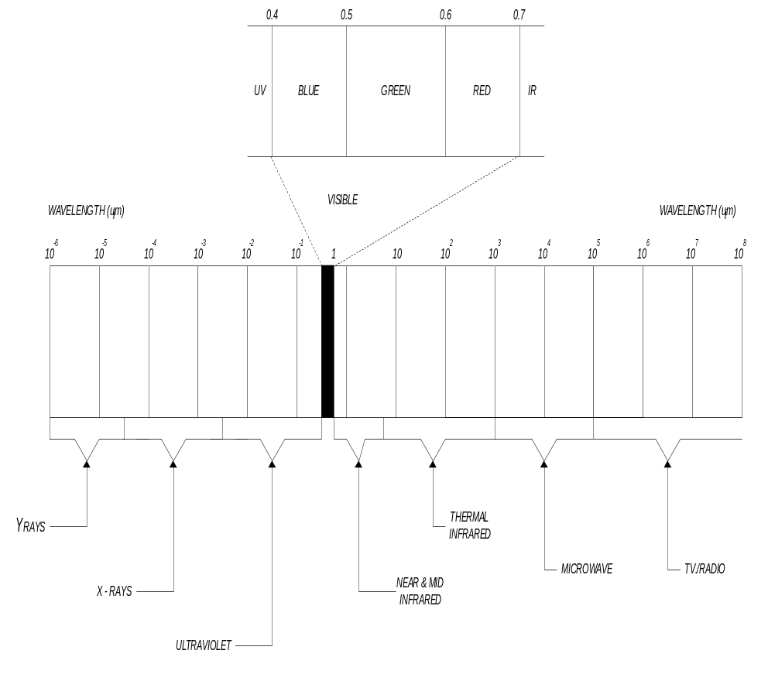
Visible wave lengths extend from 0.4 µm (distinguished as blue) to 0.7 µm (which appear as red).
Silica glass fibers are not very good transmitters of light in the visible region. They attenuate the waves to such an extent that only short transmission links are practical.
Losses in the ultraviolet are even greater.
In the Infrared, however, there are three regions in which glass is relatively efficient.
These three regions occur at wavelengths close to 0.85, 1.3 and 1.55 µm and are often referred to as the three fiber “transmission windows”.

Slide 29
WAVE POLARIZATION
Electromagnetic waves are three-dimensional waves. That is, the electric field and magnetic field vectors are perpendicular to each other and both perpendicular to the direction of propagation.
Optical waves are electromagnetic waves occupying a narrow band of the electromagnetic spectrum

Slide 30
Usually such waves generated by natural or man-made sources are referred to as unpolarized waves
Unpolarized waves are those whose magnetic and electric field components appear on a number of planes.
However, in numerous applications, the electric field vector component of the optical ray must occupy only one plane. In order to achieve this, the three-dimensional electromagnetic wave must be transformed into two-dimensional wave. This process is referred to as polarization.

Slide 31
Although light waves have much higher frequencies than do radio waves, they both obey the same laws and share many characteristics.
In free space EM waves travel at a velocity of 3x10⁸ m/s.
In solid media, the wave velocity differs. Its value depends on the material and on the geometry of any wave guiding structure.

Slide 32
The wavelength of a light beam is given by:
λ= v/f --------(1)
v= beam velocity
f= frequency
Frequncy is determined by the emitting source and does not change when the light travels from one material to another.
The velocity differs and causes a change in wavelength according to equation (1)
The intensity and velocity of light waves traveling through matter whether in a solid, liquid or gaseous state are altered to a degree determined by the physical and molecular properties of the matter.
The decrease in intensity is caused by absorption and scattering while the change in the wave velocity is caused by dispersion

Slide 33
Particle nature of light:
Sometimes light behaves as though it were made up of very small particles called photons.
The energy of a single photon is :
W_{p} = h f
where h = planck’s constant
= 6.626 x 10⁻³⁴ Jxs

Slide 34
Problem
Find the number of photons incident on a detector in 1 sec if the optic power is 1 µW and the wavelength is 0.8 µm.

Slide 35
Solution
The energy of a single photon is :
W_{p} = h f
= h (c / λ)
= (6.626 x 10⁻³⁴Jxs)x(3x10⁸ m/s) /(0.8 µm)
=2.48x 10⁻¹⁹ J
Because power is the rate at which energy is delivered. Total energy W=P t
W= (1 µ J/s) (1 s) = 1 µJ
No. of photons required:
W/ Wp = (1 µJ) / (2.48x 10⁻¹⁹ J/photon)
= 4.03 x 10¹² photons

Slide 36
Cont’d
A convenient unit of energy is:
1 ev = 1.6 x 10⁻¹⁹ J.
The 0.8 µm photon has energy in electron volts given by:
(2.48x 10⁻¹⁹ J)/(1.6 x 10⁻¹⁹ J/ev) = 1.55 eV

